Slide 1
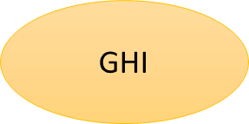
… - 01.01.2015
02.01.2015 - today
DEF
ABC
GHI
$$$
Transaction 15.11.2014 – actually posted to DEF
Transaction 15.11.2014 – in today’s report shown as posted to ABC

